Slide 1
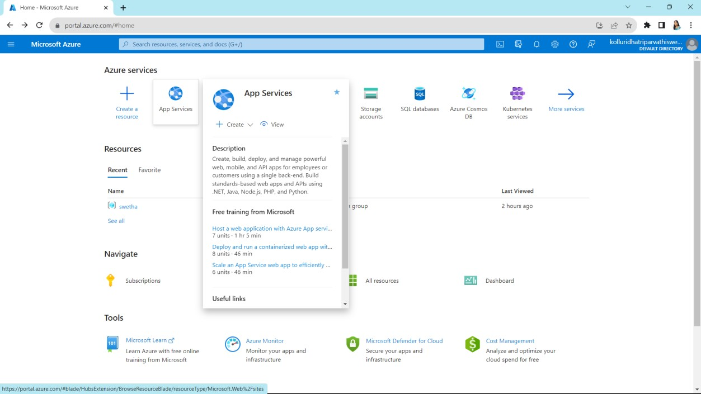
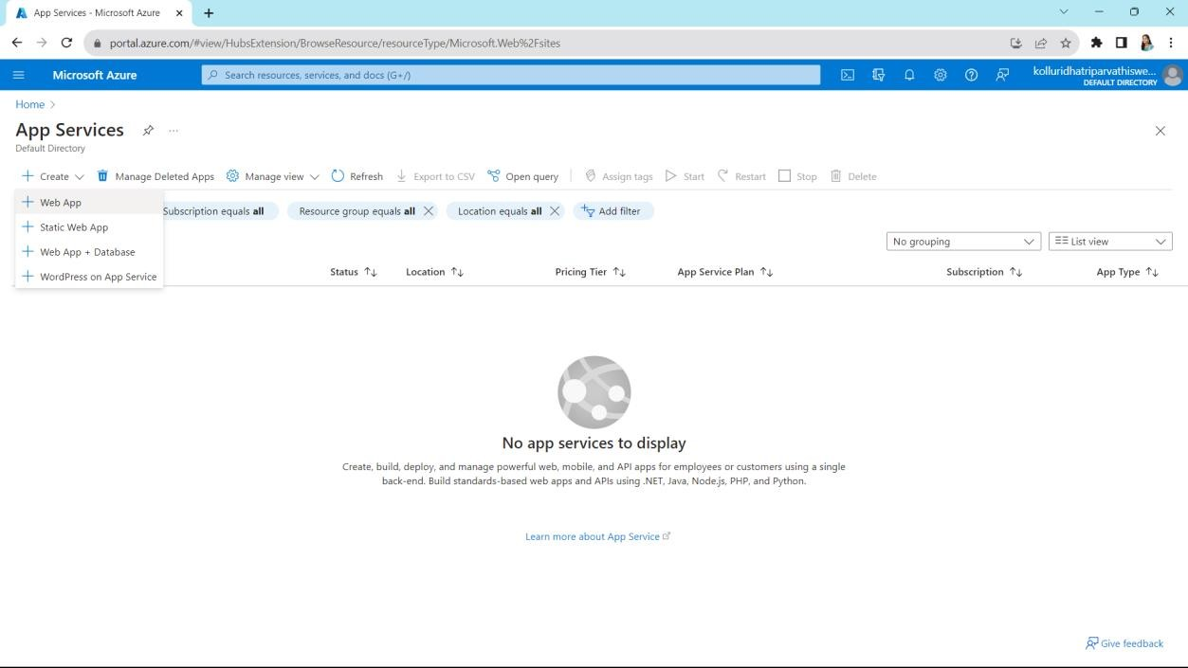
EXPERIMENT 15
Create a Simple Web Application using Java or Python and host it in any Public Cloud Service Provider (Azure/GCP/AWS) to demonstrate Platform as a Service (PaaS)
Click on app services
Click on create

Slide 2
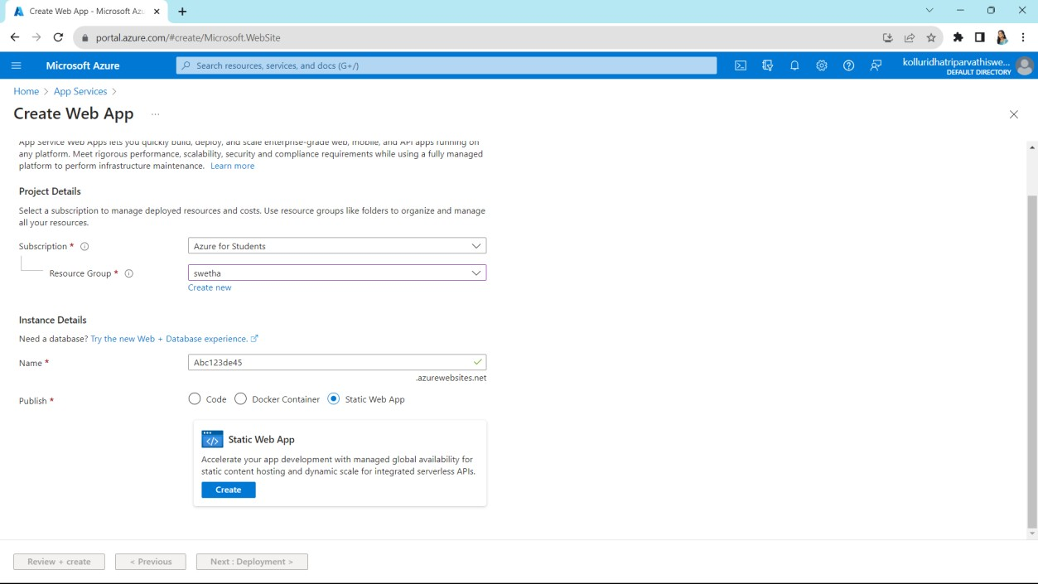
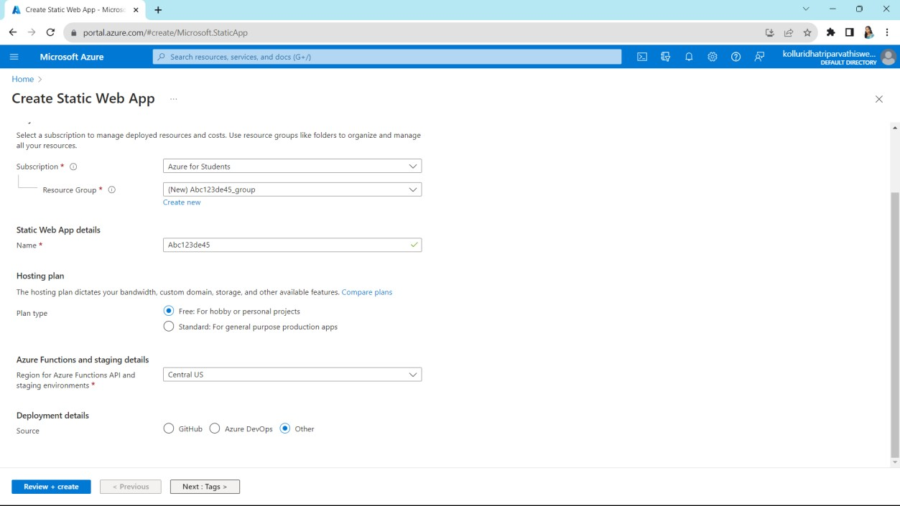
Select any resource group and
choose static web app
Fill up required details and click on next

Slide 3
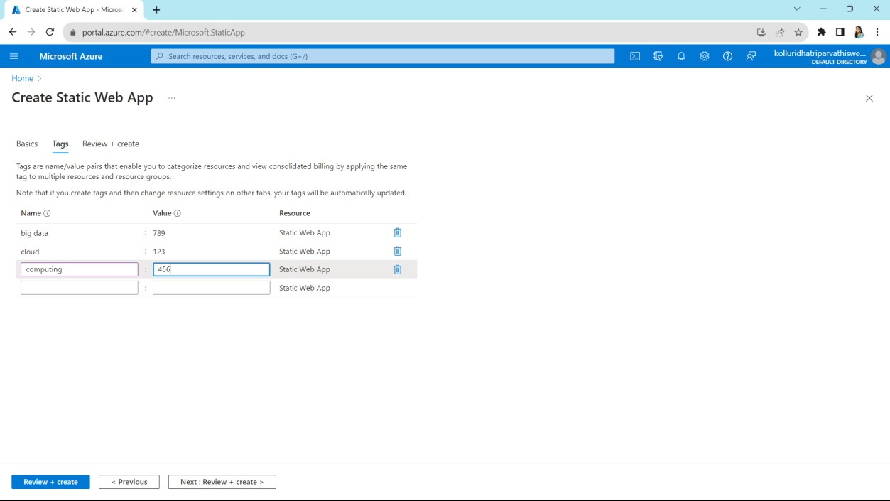
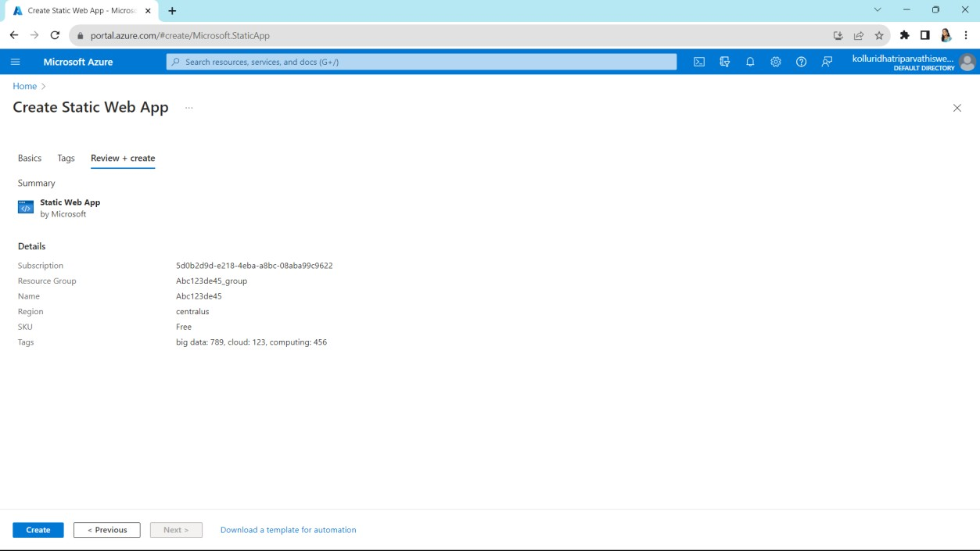
Give some names and values
It shows our summary

Slide 4
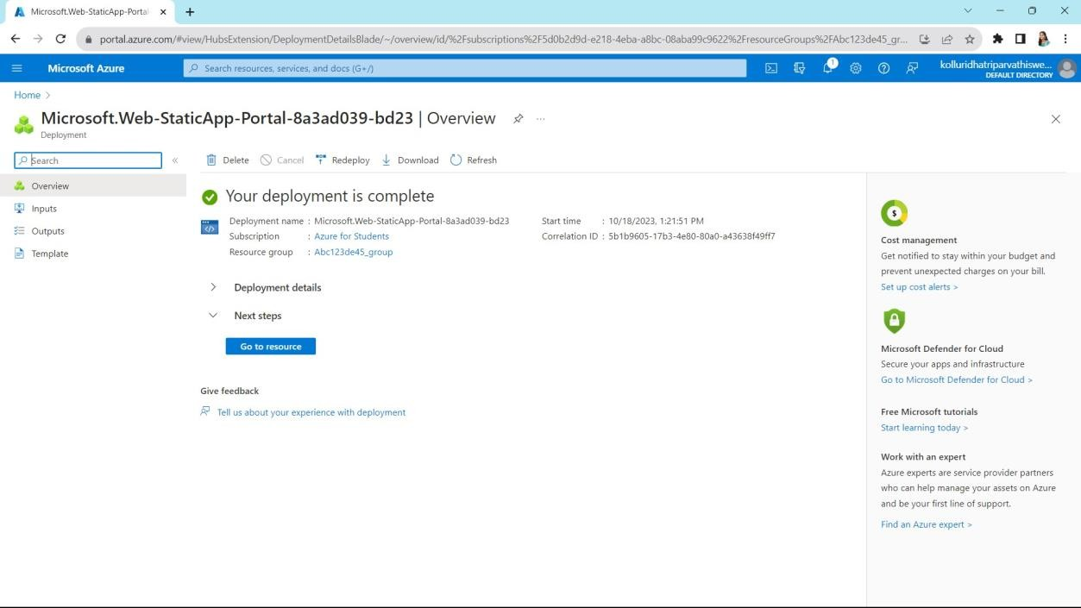
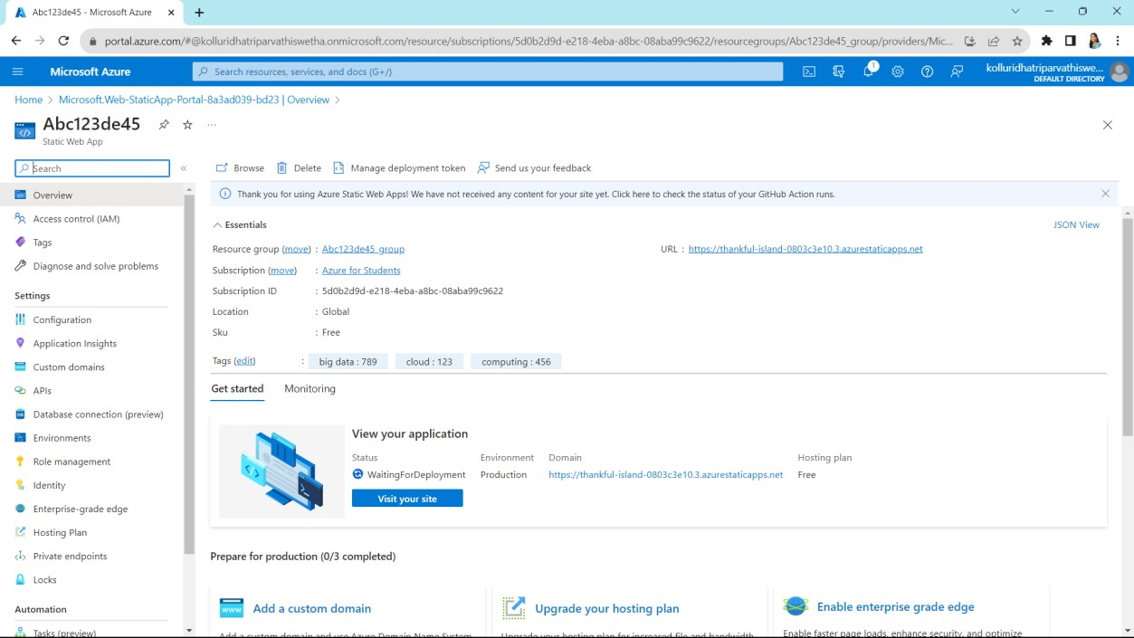
Click on go to resources
Copy the URL which is right side top

Slide 5
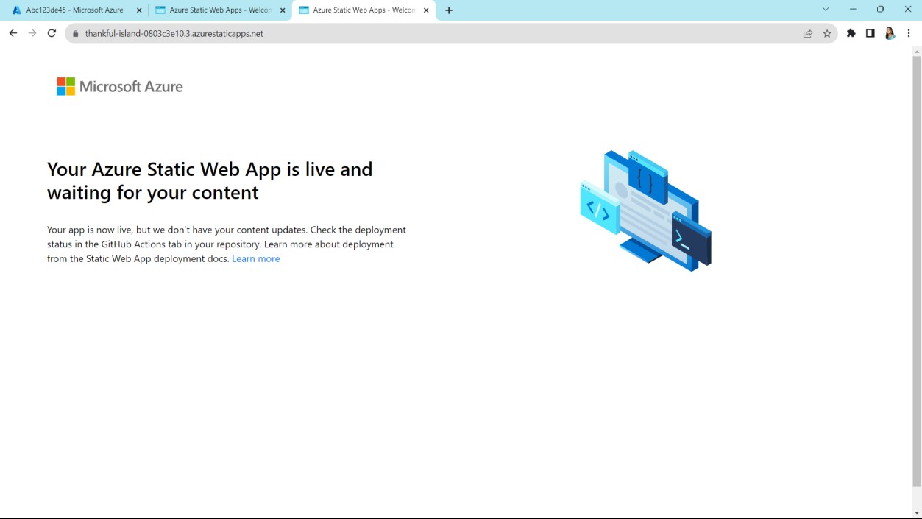
Paste the URL on search bar and then click enter it will shows like this
Finally Created a Simple Web Application

